Slide 1
Math 152 – Lesson 3
Lesson | Topic | Reading
2 | The Definite Integral | 5.2
3 | Approximate Integration | 7.7
4 | Antiderivatives | 4.9
Objectives:
Use SIMPSON'S RULE to estimate definite integrals
Know whether RHS/LHS/Trap/MP will be an over or under estimate based on slope and concavity
Use the Trapezoid Rule to estimate definite integrals

Slide 2
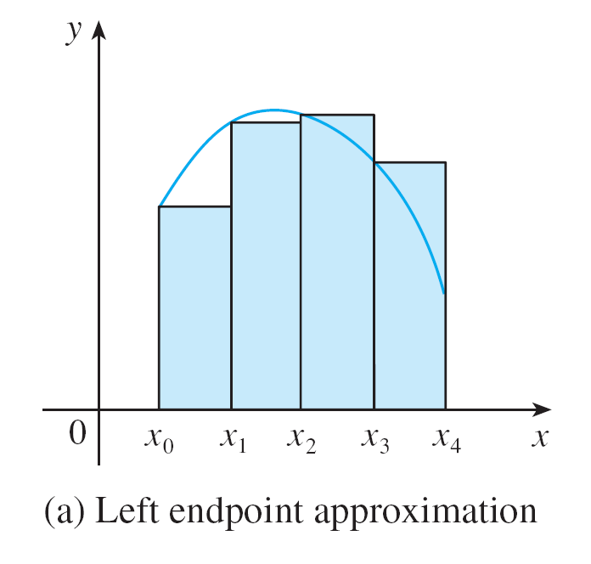
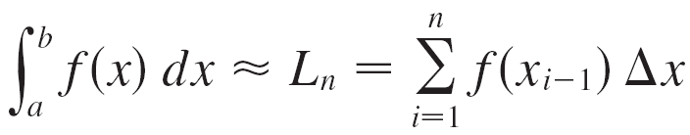
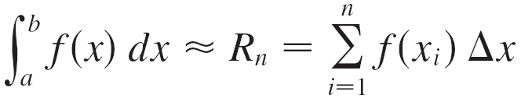

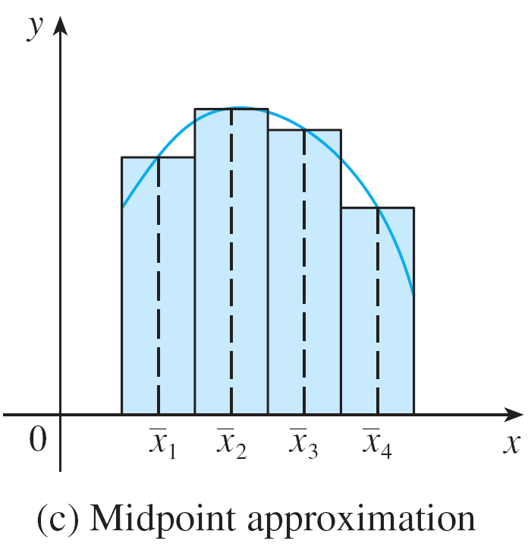
Ways to Approximate
over/under est?
over/under est?
Ave Indep var

Slide 3
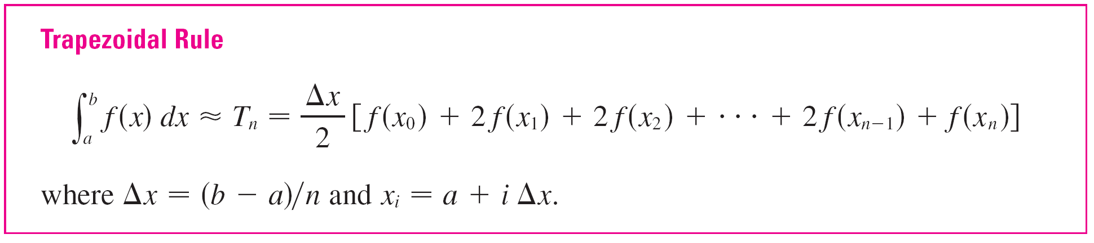
Ways to Approximate Cont
n=4 intervals
Ave dep var
Note: n+1 evaluations

Slide 4
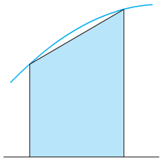
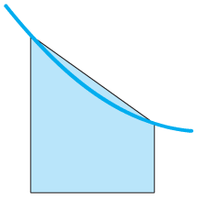
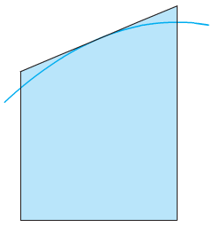
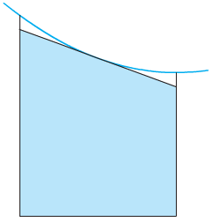
Under/Over Estimates
f Concave Down
Trapezoid Underestimates
f Concave Up
Trapezoid Overestimates
Midpoint = Ave of indep var
Trap = Ave of dep var
f Concave Down
Midpoint Overestimates
f Concave Up
Midpoint Underestimates

Slide 5
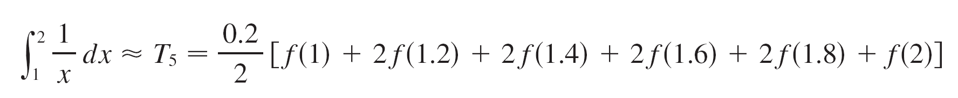
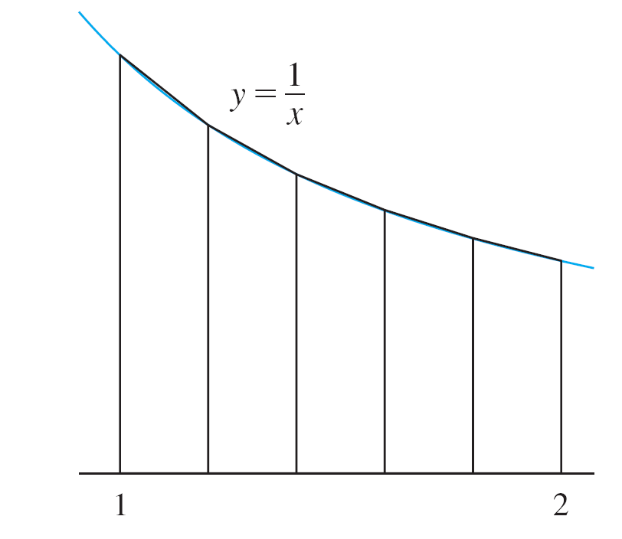
Example 1
Use n = 5 to approximate the integral
(a) the Trapezoidal Rule
(b) the Midpoint Rule with
Solution:
(a) With n = 5, a = 1 and b = 2 => Δx = (2 – 1)/5 = 0.2
≈ 0.695635

Slide 6
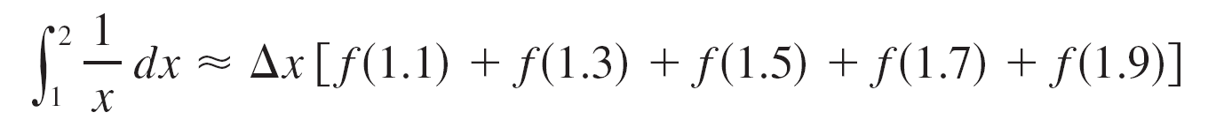
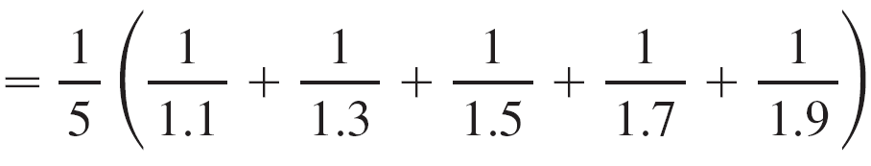
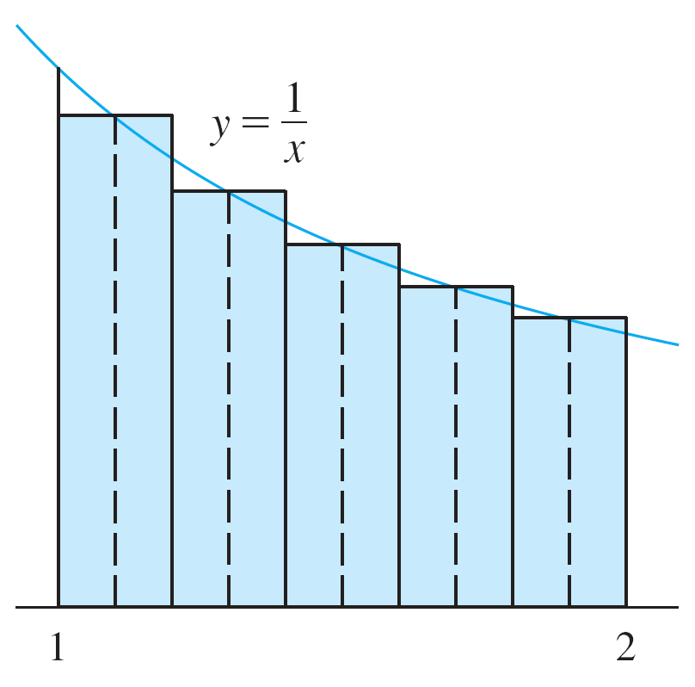
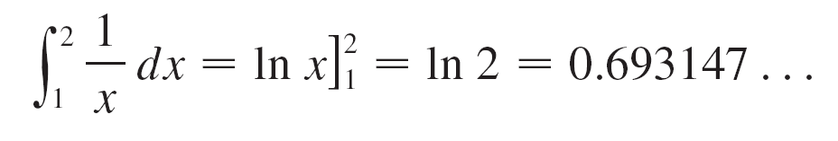
Example 1 – Solution
cont’d
(b) The midpoints of the five subintervals are 1.1, 1.3, 1.5, 1.7, and 1.9, so the Midpoint Rule gives
≈ 0.691908
Figure 4

Slide 7
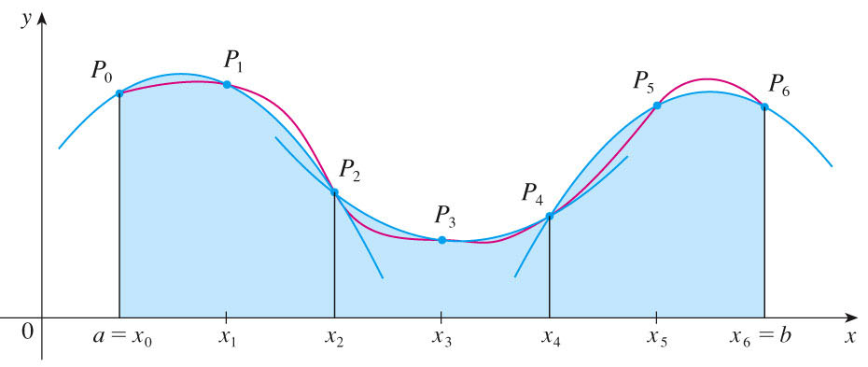
Simpson’s Rule
Combining Left and Right estimates Gave us a better estimate using Trapezoids
Simpson’s rule combines Trap and Mid to give an even better estimate using parabolas
Notes:
P513
Approximate integration technique using 3 points to define a parabola.
$SIMP\left(n\right)=$ $\frac{∆x}{3}$[$P_{0}$+${ 4P}_{1}+{2P}_{2}$ + ${4P}_{3}+{2P}_{4}$ + ${4P}_{5}+P_{6}$]
Which turns out to be the same as $SIMP\left(2n\right)=\frac{2∙MID\left(n\right)+TRAP(n)}{3}$, where in this case 2n = 6, so n=3 divisions
This example takes the $SIMP\left(2n\right)=\frac{2∙MID\left(n\right)+TRAP(n)}{3}, where n=3,$and works it backwards to arrive at
$SIMP\left(n\right)=$ $\frac{∆x}{3}$[$P_{0}$+${ 4P}_{1}+{2P}_{2}$ + ${4P}_{3}+{2P}_{4}$ + ${4P}_{5}+P_{6}$], where n = 6
Don’t stress memorizing this one

Slide 8
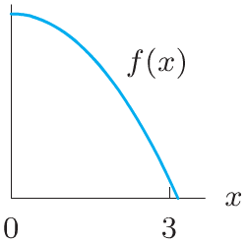
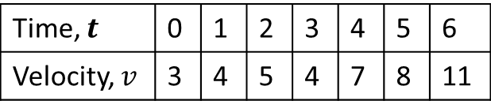
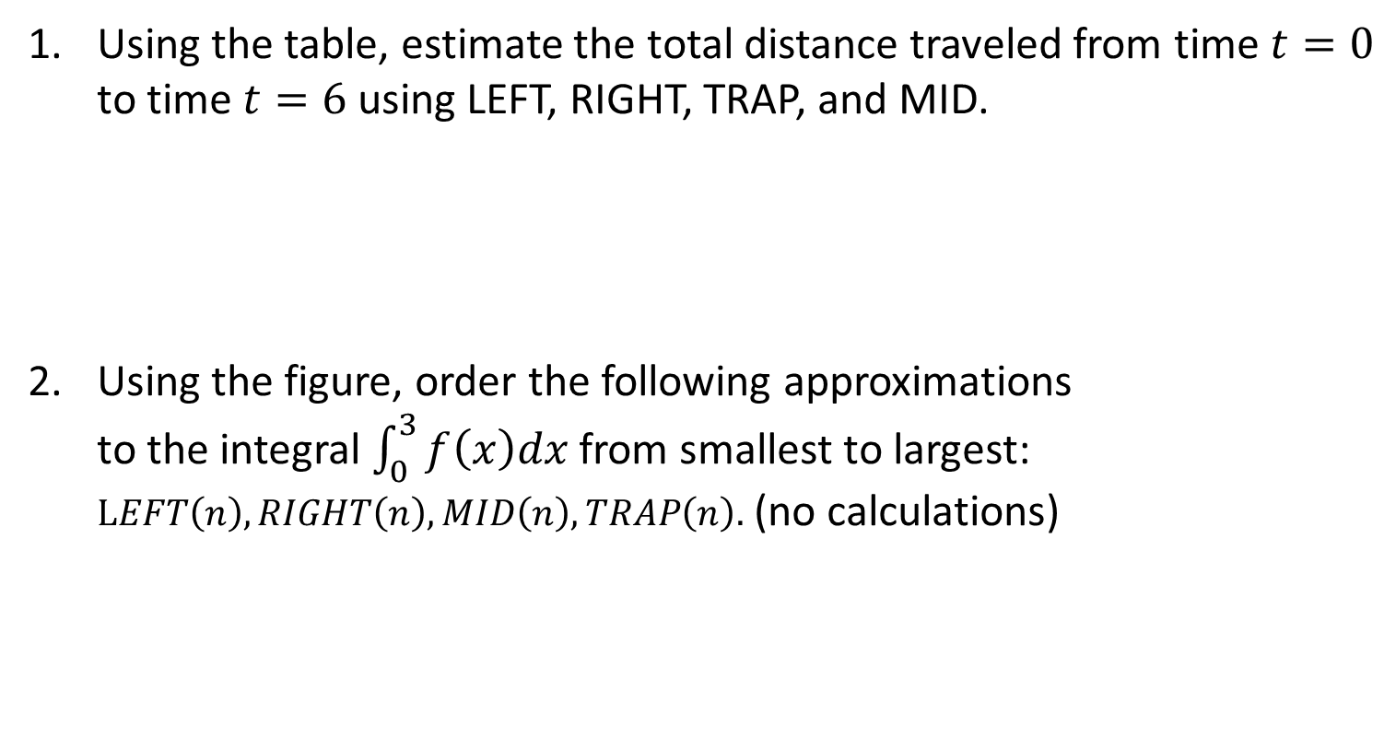
Board Work
Using the table, estimate the total distance traveled from time $t=0$ to time $t=6$ using LEFT, RIGHT, TRAP, and MID.
Using the figure, order the following approximations to the integral $\int_{0}^{3}{f\left(x\right)dx}$ from smallest to largest: $LEFT\left(n\right), RIGHT\left(n\right), MID\left(n\right), TRAP\left(n\right).$ (no calculations)
Time, $t$ | 0 | 1 | 2 | 3 | 4 | 5 | 6
Velocity, $v$ | 3 | 4 | 5 | 4 | 7 | 8 | 11

Slide 9
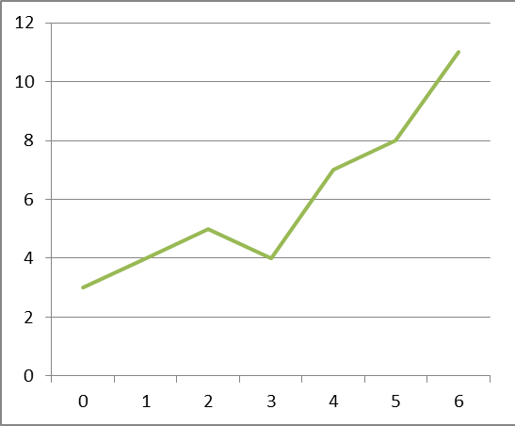
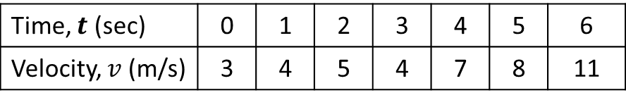

Solution 1
Using the table, calculate the best estimate for the total distance traveled from time $t=0$ to time $t=6$ using LEFT, RIGHT, TRAP, and MID.
Time, $t$ (sec) | 0 | 1 | 2 | 3 | 4 | 5 | 6
Velocity, $v$ (m/s) | 3 | 4 | 5 | 4 | 7 | 8 | 11
T-6 = ½(3+8+10+8+14+16+11) = 35
M-6 = 1(3.5+4.5+4.5+5.5+7.5+9.5) = 35

Slide 10

Solution 2
Using the figure, order the following approximations to the integral $\int_{0}^{3}{f\left(x\right)dx}$ and its exact value from smallest to largest: $LEFT\left(n\right), RIGHT\left(n\right), MID\left(n\right), TRAP\left(n\right), Exact value.$
f Concave Down
Trapezoid Underestimates
f Concave Down
Midpoint Overestimates
RHS
EXACT
LHS
TRAP
MP
Under Est
Over Est
Notes:
7.7#2…f(x) is concave UP…R<M<exact<trap<L

Slide 11
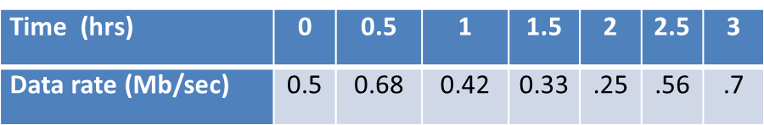
Simpson’s Rule
Use Simpson’s Rule to estimate the amount of data received over the given time period.

Slide 12
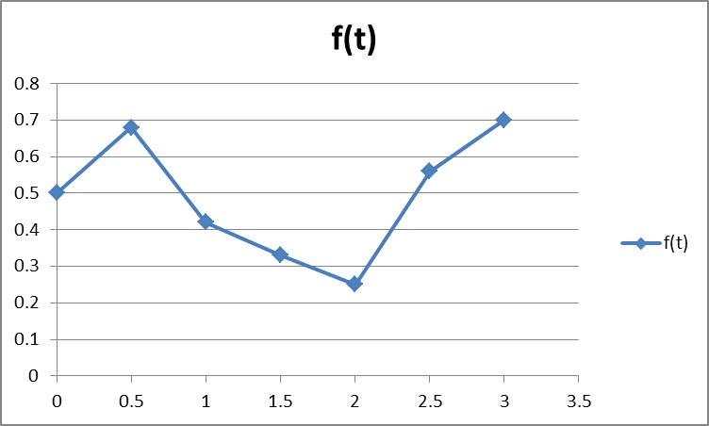
Simpson’s Rule

